Slide 1



Crafting Sustainable Solutions: Mediation in the area of geographical indications for craft and industrial products, wine, spirit drinks and agricultural products
Pr. Caroline LE GOFFIC

Slide 2
What is mediation?
A structured process through which two or more parties involved in a dispute attempt, on a voluntary basis, to reach an agreement to settle their dispute with the assistance of a mediator, under strict rules on confidentiality (EUIPO Rules on Mediation)
Voluntary: parties choose to mediate and may withdraw at any time; good faith expected
Non-binding: outcomes depend on agreement; no legal effect without consent
Confidential: discussions and negotiations remain private for all participants
Mediator’s role: supports dialogue; no power to decide or give legal advice
Speed: can solve a dispute faster than in Court

Slide 3

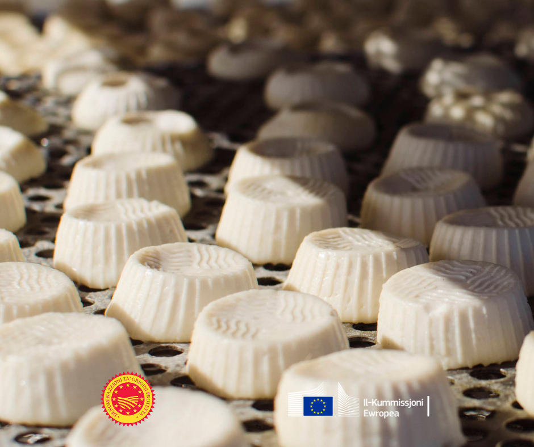
What are Geographical Indications?
Indications which identify a good as originating in the territory of a Member, or a region or locality in that territory, where a given quality, reputation or other characteristic of the good is essentially attributable to its geographical origin.
GIs in the UE:
GI protection for craft and industrial products. Regulation (EU) 2023/2411
GIs for wine, spirit drinks and agricultural products. Regulation (EU) 2024/1143

Slide 4
Geographical Indications and Mediation: an oxymoron?
GIs are very different in nature from other IP rights
Not private property rights
Strongly marked by public order / public policy concerns
Strong involvement of public authorities:
  Registration
  Official Controls and enforcement
    Obligation for Member States to designate competent authorities
    CJEU, C‑159/20, Feta, 2022: ex officio obligation to prevent / stop infringing uses

Slide 5
Still… Mediation exists in GI law
Not mentioned in Reg. 2024/1143
Reg. 2023/2411:
The Office should encourage parties to use ADR (e.g. mediation).
The Office should provide these services itself, while parties may also use external mediation services.
Art. 25(4) (opposition)
If admissible, Office invites parties to consultations for friendly settlement (max. 3 months). The period can be extended once (max. 3 months) on joint request.
The Office shall offer ADR/mediation for these consultations (Art. 170, Reg. 2017/1001).
Art. 33(5) (Appeal)
The Office shall offer ADR/mediation with the aim of reaching a friendly settlement

Slide 6
Use cases for Mediation
GI disputes occur at many times and between different actors:
  Between operators
  Between operators and third parties
  Between offices and producers’ associations
In general:
  Mediation is more likely to work when the dispute is “internal”
  Disputes in specific circles / communities
  Human factor, family dramas

Slide 7
Use cases for Mediation: GI disputes between operators
At the beginning of a GI project:
  Yes/no? - Useful/useless?
  Other distinctive signs already exist (collective/certification marks) – are they sufficient?
  Very frequent disputes and Court Challenges (Savon de Marseille, Linge basque, Laguiole, Porcelaine de Limoges) – issue: strict timeline and deadlines
When drafting the product specifications:
  Geographical area?
  Technical specifications?
  Restrictions of use?
During the “life” of a GI:
  Defense strategy?
  Investments to be made? / Costs of membership/controls?
  Communication strategy?
  Owners of previous TM forced to limit the scope of their marks – disappearance of old and established customs

Slide 8
Use cases for Mediation: GI disputes between operators and third parties
Common misconception: third parties are convinced that GIs are generic terms
French experience: mediation is frequently ordered by Courts
  Too late: at the end of the procedure, just before pleadings
  After 1 or 2 years of judicial procedure
  Poor results: third parties are convinced that they are acting in good faith
Advantages of early mediation
With expert mediators who understand the difference between GIs and TMs

Slide 9
Use cases for Mediation: GI disputes between Offices and producers’ associations
French experience: INPI is sometimes the ‘punching ball’ of producers’ associations
EU law: mediation is mostly between private parties: “with a view to assisting the parties to reach a friendly settlement”
“Exotic” Suggestion: mediation also between Offices and producers?
Might prevent years of disputes?

Slide 10

THANK YOU
caroline.legoffic@univ-lille.fr

